Slide 1
Innovative approaches to designing engagement and evaluation in integrated care
Session 9.4 Wednesday October 16 2024, 2:30 – 4:00pm
Dr Yumiko Olliver and Kāroria Johns

Slide 2
1. How can silenced voices be better gathered and heard for outstanding ‘health’ and wellbeing? 2. How can ‘evaluation’ be most meaningful for our people and communities? 3. How can ‘engagement’ and ‘evaluation’ be reimagined to capture silenced voices?

Slide 3
We would like to explore with you:
What else is needed to be responsive to other ways of knowing?
What could be next, as a network of practitioners/ knowledge weavers, to develop excellence in this space?

Slide 4
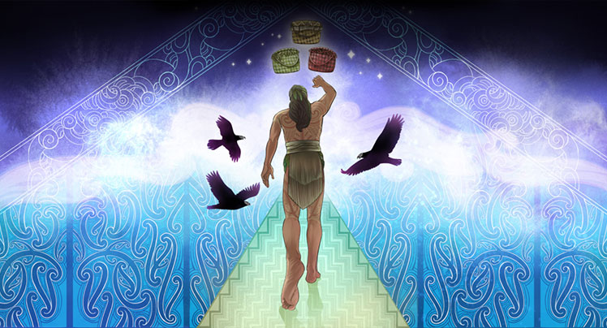
Illustration credit: https://www.izzyjoyart.com/

Slide 5
Tihei-wa Mauri ora – a resource
Te Korekore (pitch black) the vast mass of potential being, imbued with divine essences.
[conception]
Te Pö realms (various shades of black) darkness and night stages of growth and development.
[child grows within the mother’s womb]
Te Whei-Ao (reds/orange) the realm of coming into being, critical changes and transition, glimmer of light.
[mother goes into labour in process of birthing]
Ki Te Ao Marama (white/light blue) the realm of light and being, this world, mortality.
[child is born into the world of light]
Tihei-wa Mauri Ora! (Blue/green) the living breath of life.
Developed by Teina Piripi and Vivienne Body. https://tihei-wamauriora.mystrikingly.com/
Additional resources and Piripi, T., & Body, V. (2012). Tihei-wa Mauri Ora: Te Tipuranga. In P. Culbertson, M. N. Agee, & C. Makasiale (Eds.), Pacific Identities and Well-Being (1st ed., pp. 12). Routledge. https://doi.org/10.4324/9780203113578

Slide 6
Hei Tiki wisdom
Hinengaro
Head
Thinking / IQ
Ngakau
Heart
Feeling / EQ
Puku
Gut
Instinct / PQ
Notes:
EQ / IQ / Physical or Primal Quotient

Slide 7
Hei Tiki wisdom
Head
Hinengaro
Head
Thinking / IQ
Heart
Vestibulum congue
Gut
Notes:
My life story
My back story
Start with HN, expanded network, met Amarjit, met Andrew and Sarah.
Supported by having invoices done, reminded of appointments, having ‘buddies’
Tacit knowledge vs implicit knowledge

Slide 8
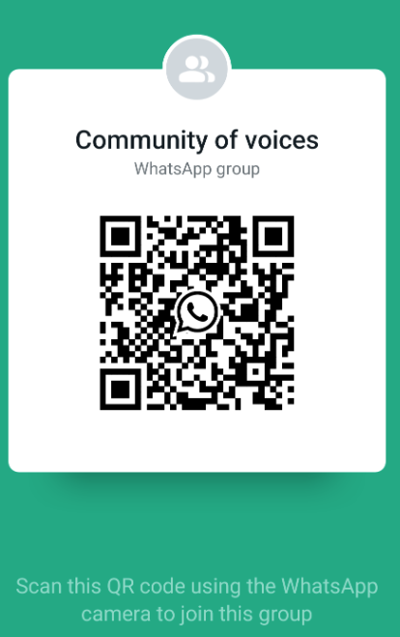
https://chat.whatsapp.com/D4FJKXtKLt04yr1FXMTT2U

