Slide 1
Exploring creative approaches to hearing silenced voices
The North American Conference on Integrated Care 2024
Dr Yumiko Olliver
Connecting Communities Manager, THINK Hauora, Mid-Central Aotearoa New Zealand

Slide 2
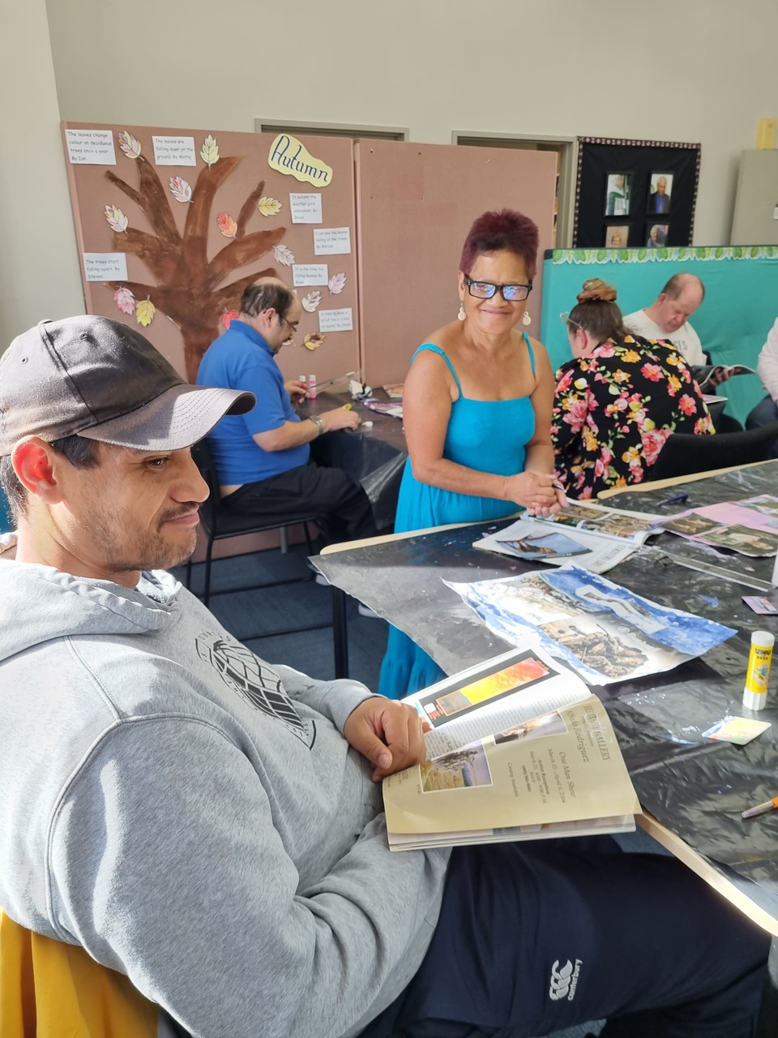
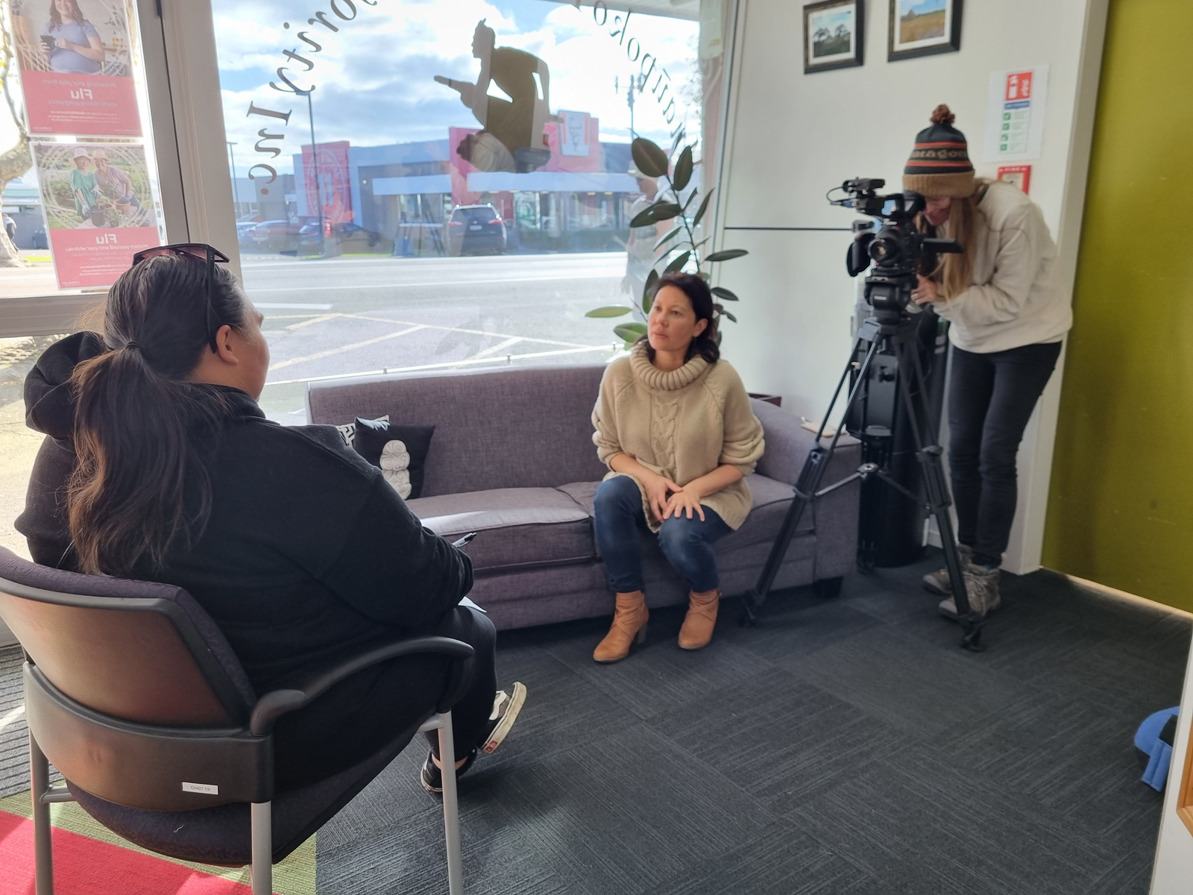

Slide 3
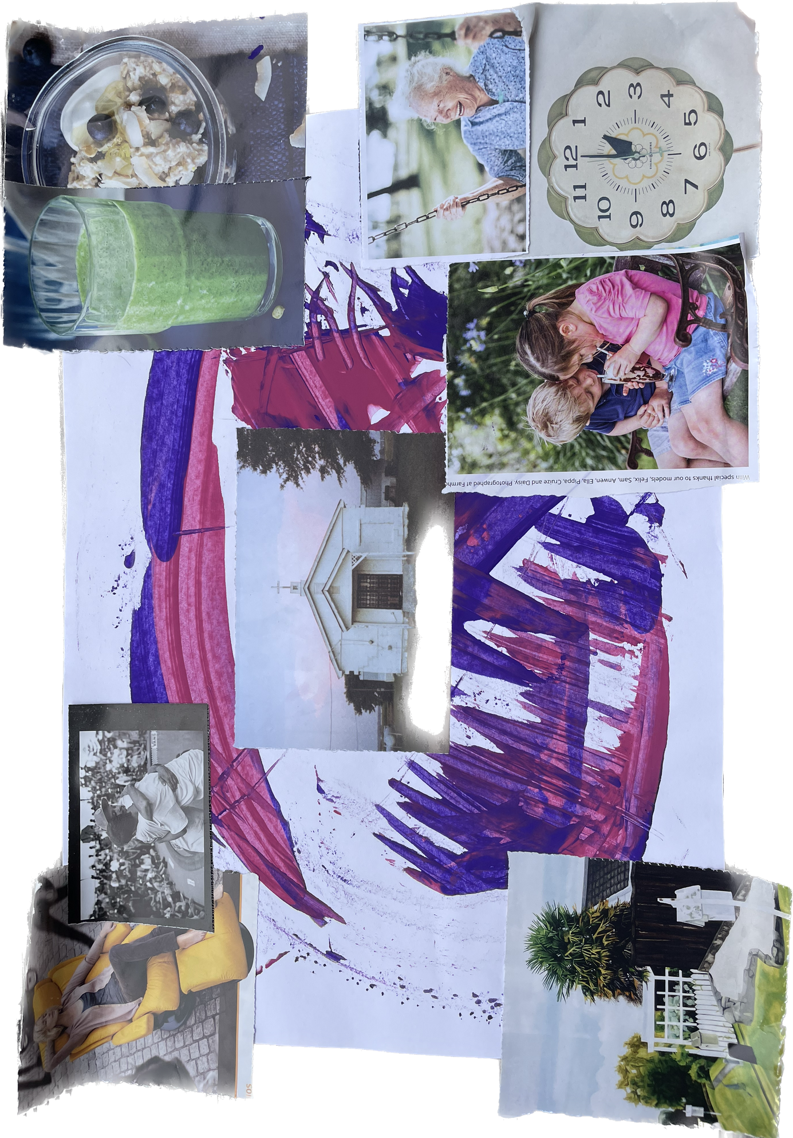
What does hauora mean to you?
The pillars of wellbeing are our family and friends, good health, clean water, making the most of your time, caring for our elderly and children, relaxing,. Religion and spiritual wellbeing is important for healing too.
Alice

Slide 4
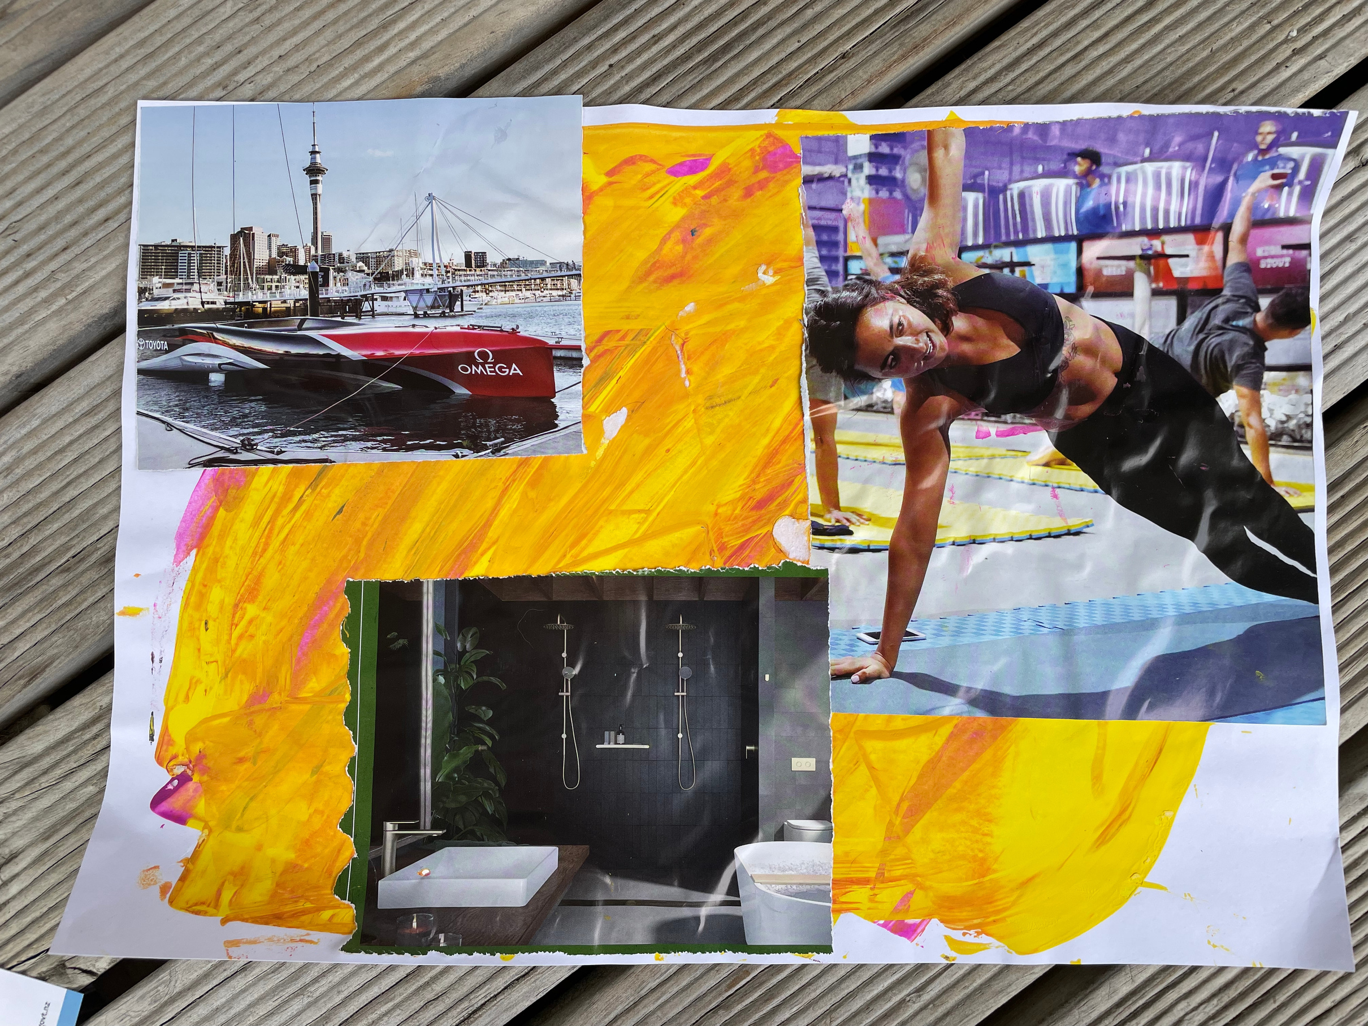
What more do you need to be well?
A gym for women, I’ve seen one in Porirua, as it is tapu for us to go when men are there and exercise is important for our wellbeing.
The boat represents transport - there is no public transport to get to the doctors in Palmerston North. And having a healthy home makes one healthy. - Ari

Slide 5
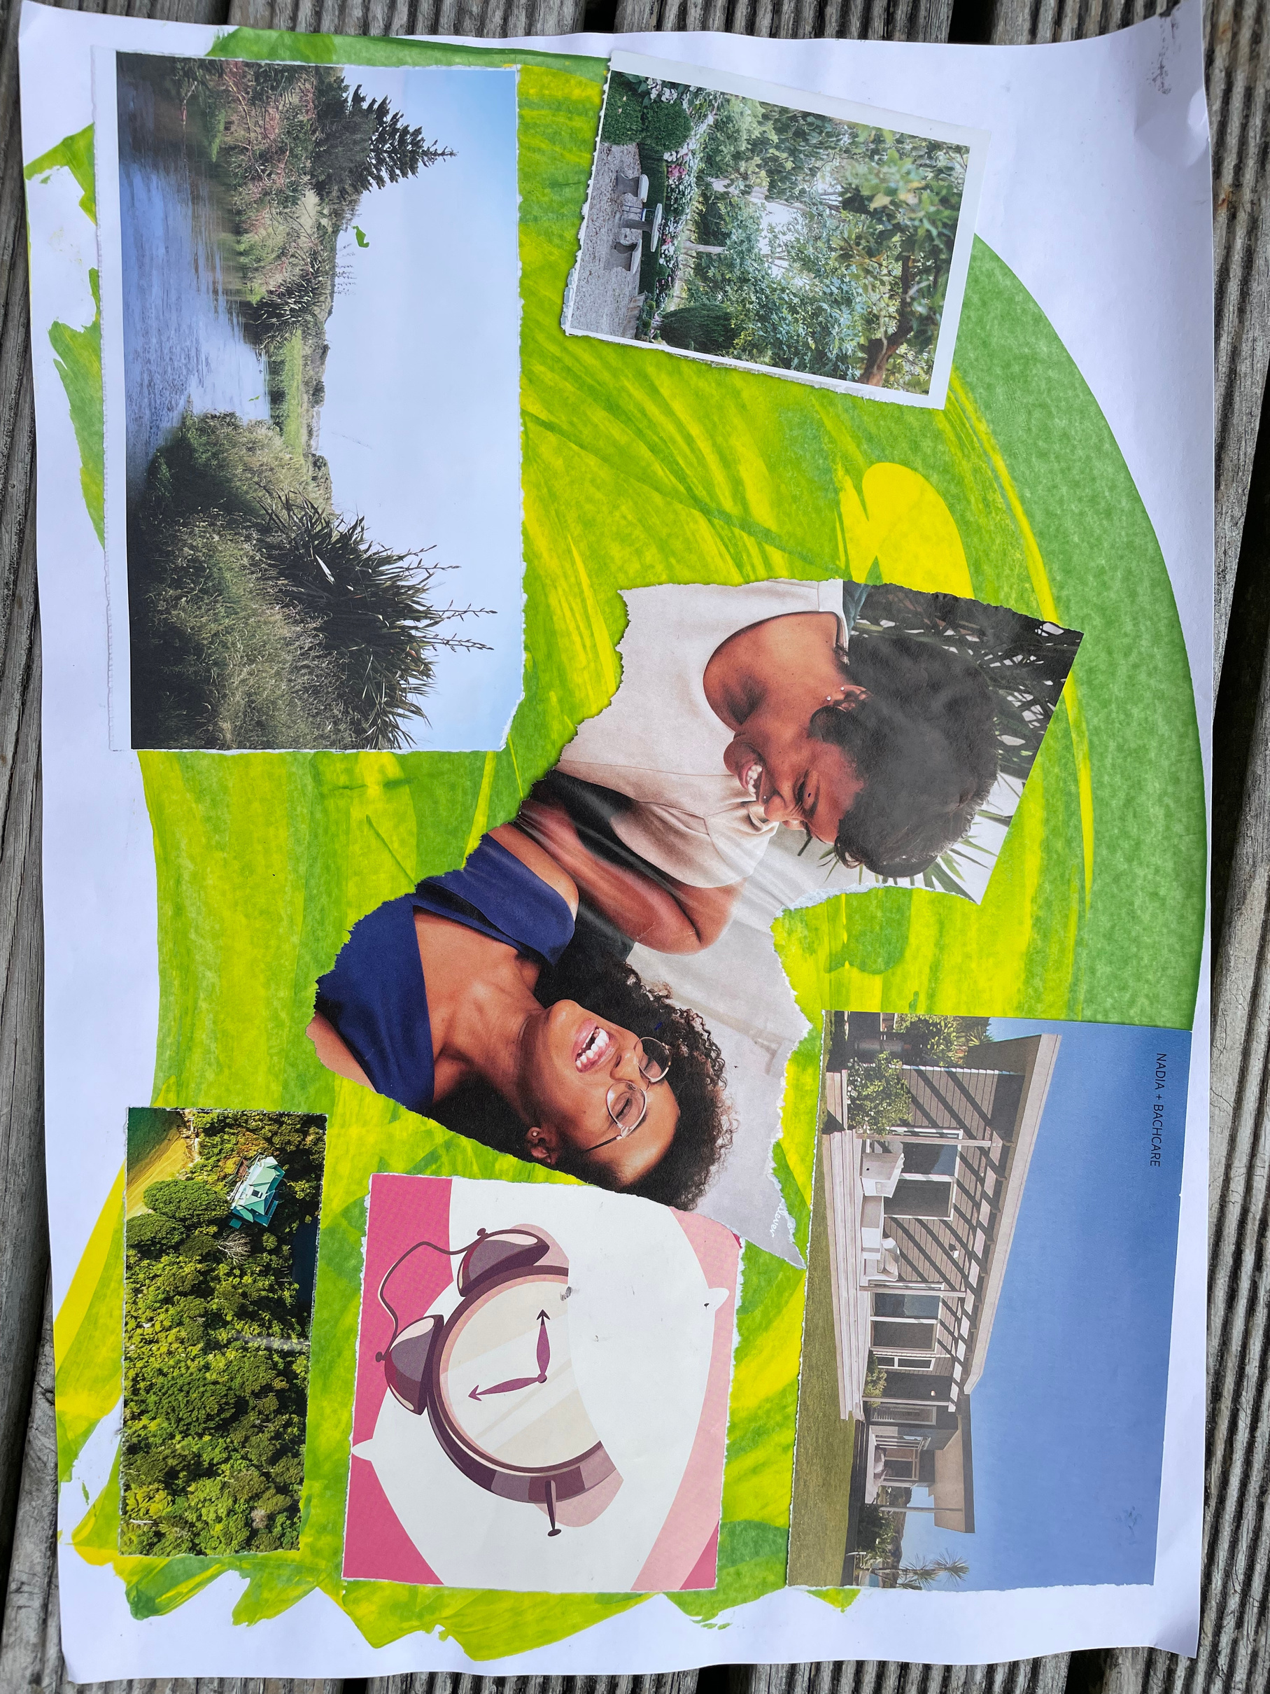
What else do you need for hauora in Horowhenua?
A beautiful house that people can walk into anytime and be helped, 24/7. No need to make appointments, so not time constrained.
That people can have conservations together, face to face and feel welcome. The trees are like back home, natural, and everyone feels welcome. - Rasella

Slide 6

What does being well mean to you?
The lake, being Māori and looking after that lake. Healthy models, natural environment and animals. The male lion is like the father looking out for us - Tina

Slide 7

What is your dream for wellbeing?
Being with family. Having family around. Someone to care for you and care about. - Bruce

Slide 8
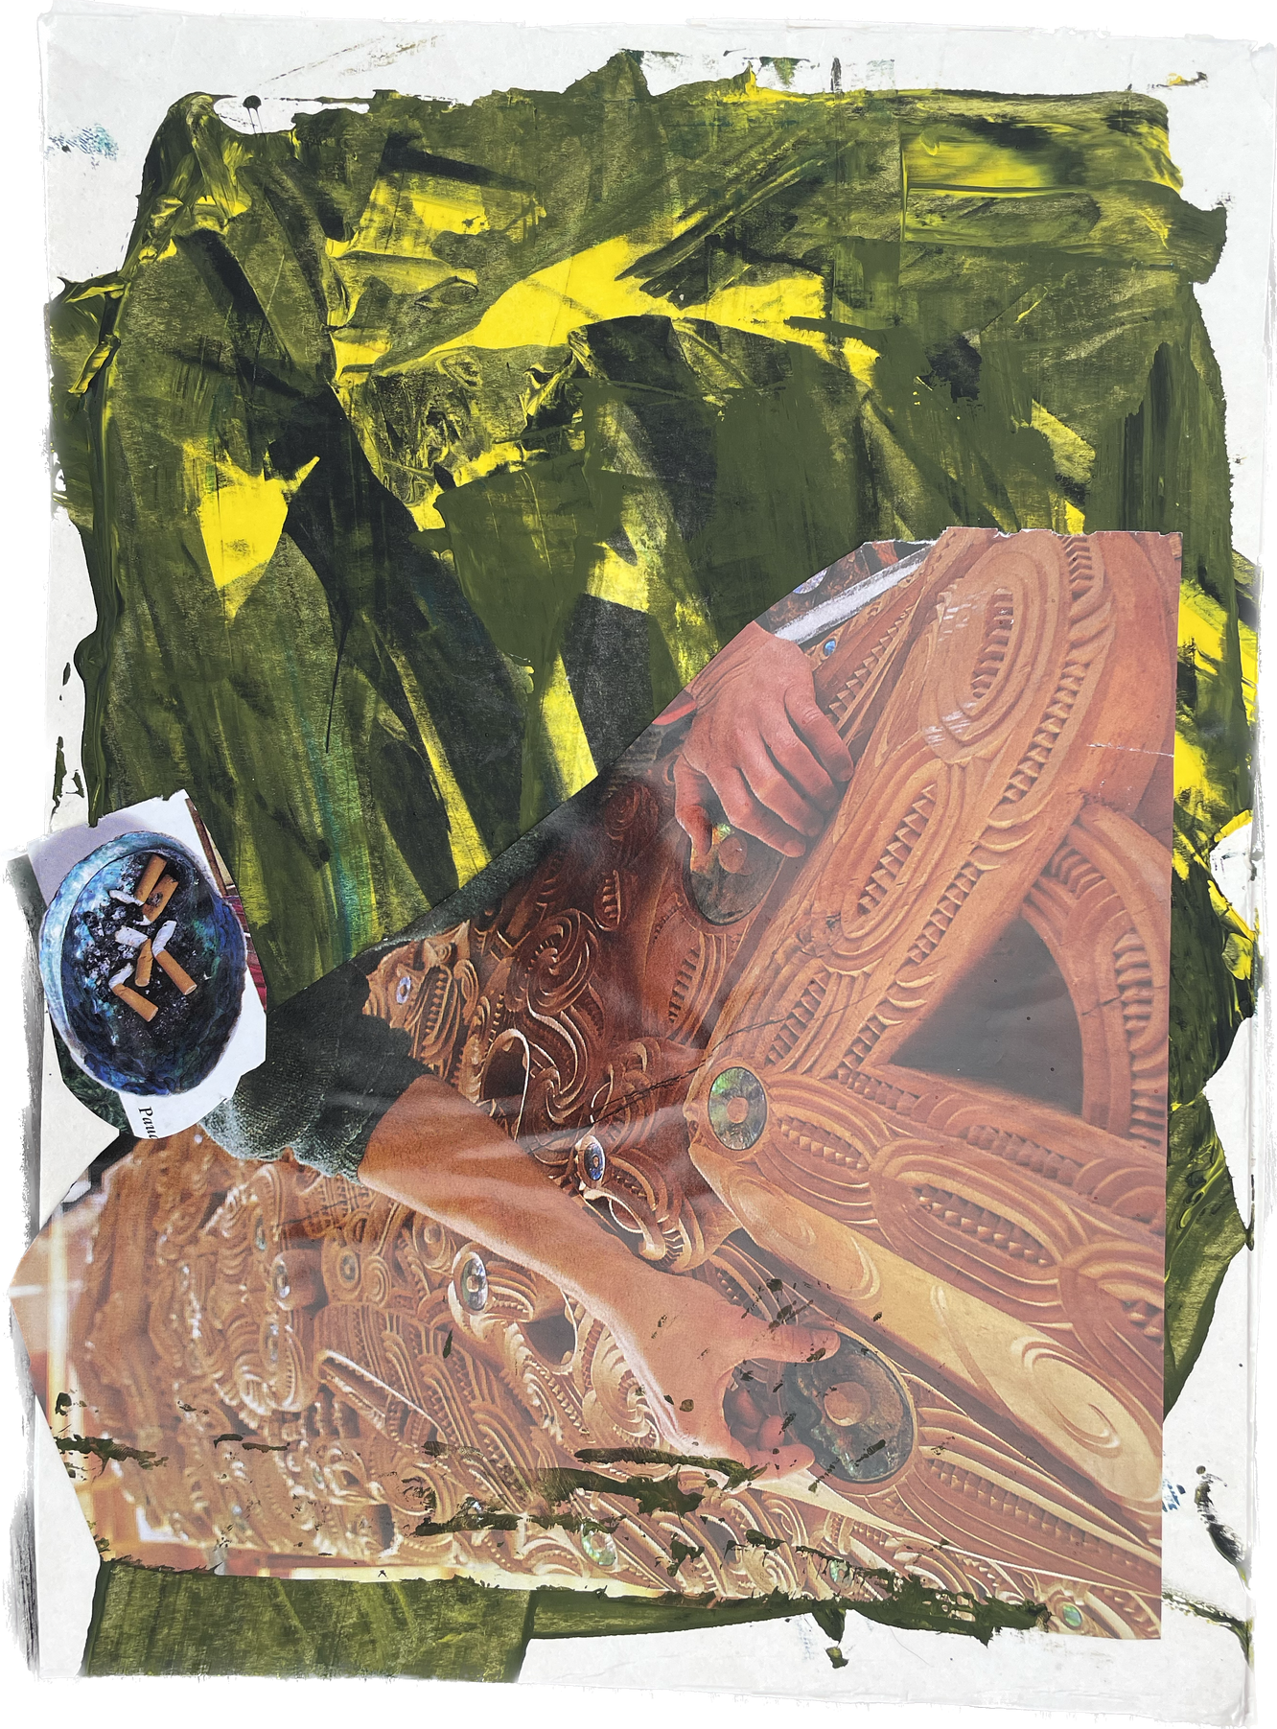
“It would be good to have more carvings around the town, things that are beautiful and are more about the iwi here and Māori. I want to see more of my culture, not only at events.” "And to stop kids smoking and vaping. That's what the cigarettes are there for.” - Amai

Slide 9
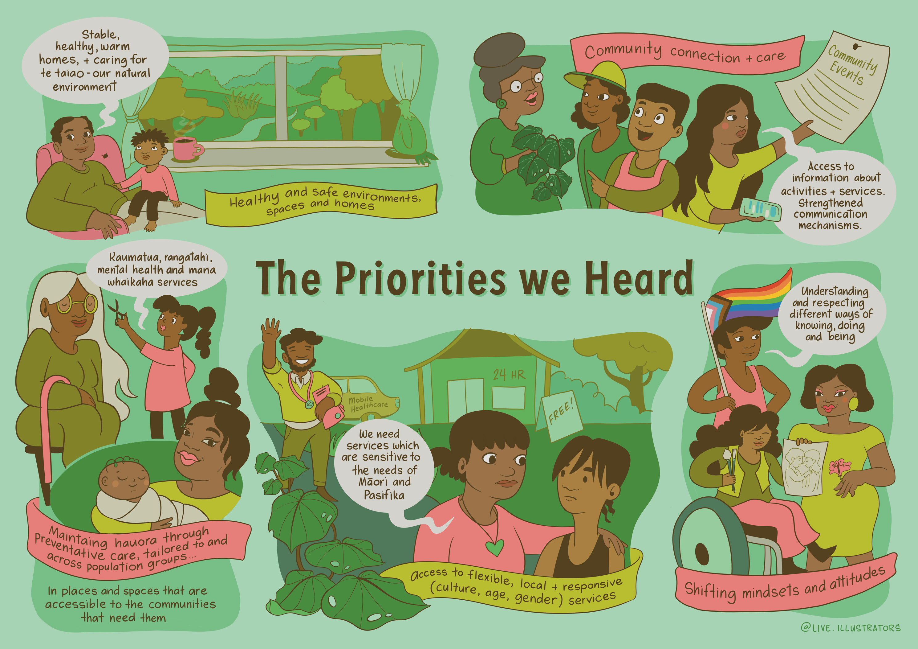

Slide 10

Let’s stay connected

